Slide 1

Introduction to mixed-effects regression
Natalia Levshina
Jena WiSe 2017-2018

Slide 2
Outline
1. Why are mixed models important?
2. Case study: help + (to) Infinitive

Slide 3
Why are MM important?
Imagine some data about sales of ice-cream on one day by people in different countries.
We also have data about the temperature on that day.
What kind of relationship would you expect?

Slide 4
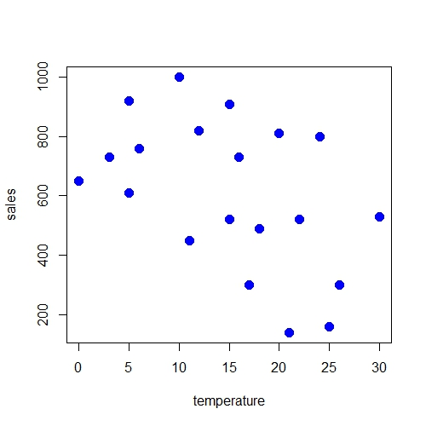

Slide 5
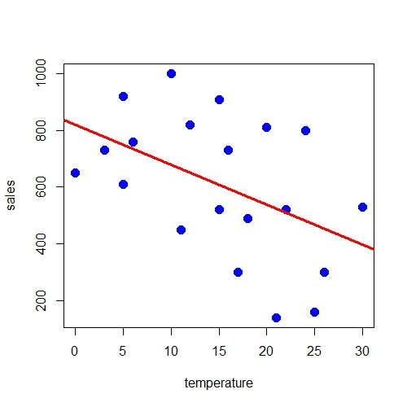

Slide 6
Simple linear regression
Estimate Std. Error t value Pr(>|t|)
(Intercept) 820.698 105.376 7.788 3.58e-07 ***
temperature -14.166 6.145 -2.305 0.0333 *
The effect is negative: the warmer it is, the less ice-cream is sold. This is unexpected.

Slide 7
Dependent observations
But the observations actually come only from five countries:
Finland
Ireland
Italy
China
India

Slide 8
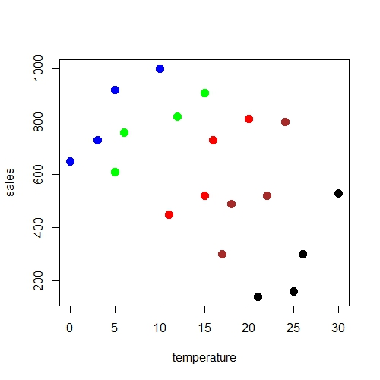

Slide 9
Mixed model: Fixed effects
Estimate Std. Error t value
(Intercept) 65.939 244.261 0.270
temperature 35.984 5.377 6.692
The effect is now positive: the warmer it is, the better are the sales!

Slide 10
Mixed model: Random intercepts
$country
(Intercept)
Finland 593.164376
Ireland 364.771634
Italy 3.781836
China -265.342374
India -696.375471
Average preference for ice-cream in each country (the mean is zero).

Slide 11
Interpretation of random intercepts
RI are used when one and the same adjustment can be added to all members of one group.
But the effect of the predictor is the same in each group.

Slide 12
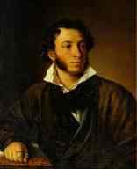
A hypothesis
“The less we love her when we
woo her, the more we draw a
woman in.”
Alexander Pushkin,
Eugene Onegin

Slide 13
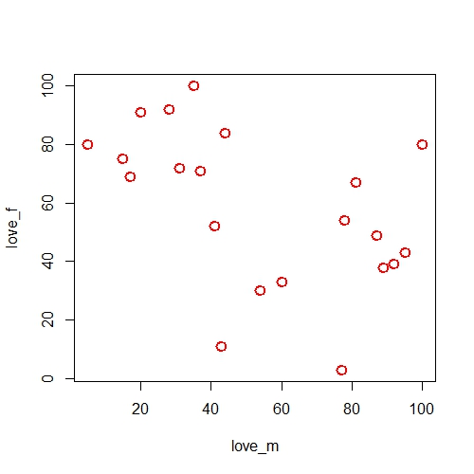

Slide 14
Simple linear model
Estimate Std.Error t value Pr(>|t|)
(Intercept) 81.7032 10.9257 7.478 4.5e-07 ***
love_m -0.4276 0.1783 -2.398 0.0269 *

Slide 15
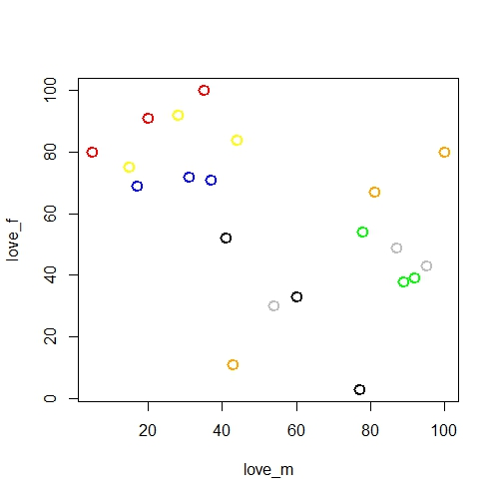

Slide 16
Mixed model with random intercepts and slopes
The effect is very weak and positive:
Estimate Std. Error t value
(Intercept) 59.20473 22.01777 2.689
love_m 0.04455 0.34546 0.129

Slide 17
Interpretation of random slopes
RS are used when the effect of a predictor on the response varies from group to group.
$Subject
(Intercept) love_m
a 20.786878 0.44339018
b 18.276733 0.15665153
c 9.441192 0.02183356
d 45.072418 -1.30241964
e 46.838881 -0.76804347
f -45.174025 0.29898868
g -95.242077 1.14959916

Slide 18
Fixed or random?
Imagine you have repeated observations from Mark Davies’s COCA components: Spoken, Magazines, Newspapers, Academic and Fiction. Should you enter these as fixed or random effects?
A rule of thumb:
If you have 2 to 5 groups in a grouping factor, you can just as well include them as proper fixed effects.
If you have more than 5 groups, it’s better to enter them as random effects because there may not be enough data points to estimate the p-values in a reliable way.

Slide 19
Outline
1. Why are mixed models important?
2. Case study: help + (to) Infinitive

Slide 20
Testing random intercepts
What about textID? Let‘s test if there is a lot of variation.
A GLMM model with converges very slowly.
Let‘s make a subset of the help_gb dataset, including only texts with frequency 5 and greater :
> textfreq <- as.data.frame(table(help_gb$textID))
> colnames(textfreq)[1] <- "textID"
> help_gb1 <- merge(help_gb, textfreq, by = "textID")
> help_gb2 <- help_gb1[help_gb1$Freq > 4,]

Slide 21
Fitting a GLM on new data
> help_fe <- glm(To ~ Formality + Helpee* HelpForm + ToHelp*LingDist + poly(Info_HELP, 4), data = help_gb2, family = binomial)

Slide 22
Adding random intercepts
> library(lme4)
> help_ri <- glmer(To ~ Formality + Helpee* HelpForm + ToHelp*LingDist + poly(Info_HELP, 4) + (1|textID), data = help_gb2, family = binomial)
Warning message:
In checkConv(attr(opt, "derivs"), opt$par, ctrl = control$checkConv, :
Model failed to converge with max|grad| = 0.172664 (tol = 0.001, component 1)

Slide 23
Convergence issues
Quite often, there is little difference between models with and without convergence issues. But it’s worth trying this fix:
> help_ri <- glmer(To ~ Formality + Helpee* HelpForm + ToHelp*LingDist + poly(Info_HELP, 4) + (1|textID), data = help_gb2, family = binomial, control=glmerControl(optimizer = "bobyqa", optCtrl=list(maxfun=2e4)))

Slide 24
Compare the coefficients
> cbind(coef(help_fe), fixef(help_ri))
[,1] [,2]
(Intercept) -4.5965943 -4.82480135
Formality 0.8385946 0.81406367
HelpeeYes -0.3079239 -0.01216618
HelpFormhelped 0.7144637 1.25987665
HelpFormhelping 2.6376705 3.14389197
HelpFormhelps 1.2449900 1.71757379
ToHelpYes -2.0461904 -2.59342360
LingDist 0.1571591 0.07022922
…

Slide 25
Random intercepts for textID
> ranef(help_ri)
$textID
(Intercept)
104608 -0.85249607
114807 0.72816290
116904 1.33977474
128505 1.08207288
130304 -0.46181837
133005 -1.53222416
…

Slide 26
Testing random slopes
Let’s test random slopes for Helpee. Does its effect vary across different texts?
> help_rs <- glmer(To ~ Formality + Helpee* HelpForm + ToHelp*LingDist + poly(Info_HELP, 4) + (1 + Helpee|textID), data = help_gb2, family = binomial, control=glmerControl(optimizer = "bobyqa", optCtrl=list(maxfun=2e4)))

Slide 27
Do we need random slopes?
> anova(help_ri, help_rs, test = "Chisq")
…
The p-value is greater than 0.05. The model is not significantly better, so we can stick to a simpler model.

Slide 28
Exercise
Take any other predictor and check if the model with random slopes will be better than the model only with random intercepts.

Slide 29
A word on maximal models
Some people (Barr et al. 2013) have argued that one needs to include all possible random effects, intercepts and slopes (so called ‘maximal’ models).
However, Bates et al. (2015) have shown that this leads to overspecification and loss of statistical power. One also has convergence problems, which are not due to bad algorithms, but because the overly complex random effect structure is not supported by the data.
This is why I recommend to fit parsimonious models and include only those random effects which are supported by your data. You can use the likelihood ratio test (with the help of anova), as shown above for that purpose.

Slide 30
Goodness of fit
Let’s compute the C index:
> somers2(fitted(help_ri), as.numeric(help_gb2$To) - 1)
C Dxy n Missing
0.8980042 0.7960084 758.0000000 0.0000000
A problem: a model with random effects nearly always gives a better fit than a model with fixed effects only.

Slide 31
Marginal and conditional R²
Marginal R² represents the variance explained by fixed factors.
Conditional R² is variance explained by both fixed and random factors (i.e. the entire model).
> library(MuMIn)
> r.squaredGLMM(help_ri)
The result is correct only if all data used by the model has not changed since model was fitted.
R2m R2c
0.2710680 0.5431697
[warning message omitted]

